Slide 1
IT890 - Professional Practice / Seminar
Presented To:
Dr. Ram Mohana Reddy Guddeti
Presented By:
Mohd Asif Khan Khaishagi(202IT013)

Slide 2
Abstract
Air is one the most important aspect of human life, but now a days due to smoke from vehicles, harmful gases from air-conditioners and refrigerator, burning of crops and forests have degraded air quality in our country as well as globally. Air pollution is among the most dangerous issues to human life. To monitor the quality of air in our surroundings is important in getting information about pollution and harmful it is to our health. In this project, I have made an indoor air quality monitor which will show what is the air quality in our surrounding as well as what is what is danger level associated with it.

Slide 3
Introduction
Air inside the house may seem harmless but there can be colorless and odourless substances in air like carbon monoxide etc. which can affect human health. So for this project, I made Indoor Air Quality Monitoring System which consists of hardware , IOT data aggregation and visualisation platform and an Android App which will show the Air quality status at real time.

Slide 4
HARDWARE COMPONENTS
Arduino UNO
MQ135 Gas Sensor
MQ7 Carbon Monoxide Sensor
ESP8266 Wifi Chip
Breadboard
Wires etc.

Slide 5
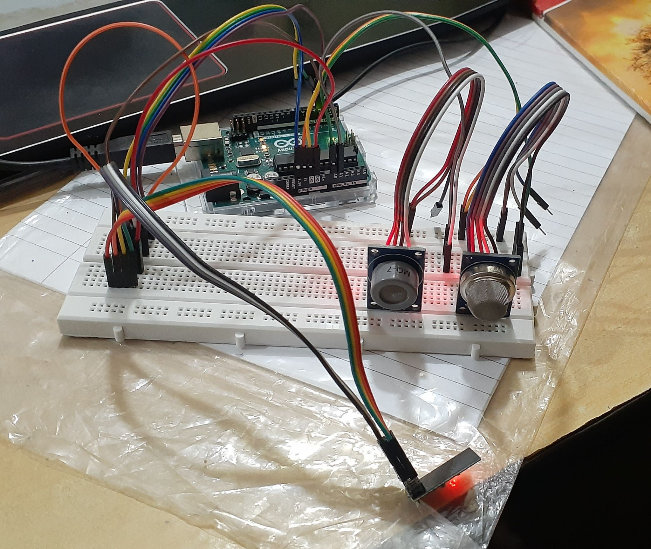
Fig 1 : Air Quality Sensor Connected And Running With Arduino

Slide 6
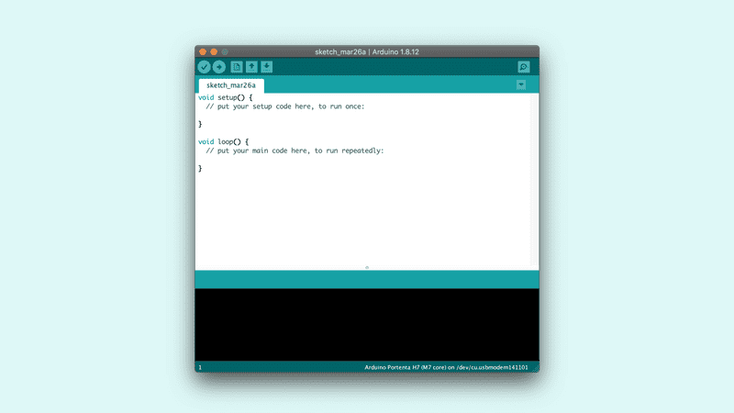
Arduino IDE
The open-source Arduino Software (IDE) makes it easy to write code and upload it to the board. This software can be used with any Arduino board.
Fig 2: Arduino IDE

Slide 7
ARDUINO CODING
Step 1 : I have written the code such that on initialization, it connects to the wifi.
Step 2 : Once connected, it will read values from sensor and push them to thingspeak channel.
Repeat Step 2 after every 1.5 second.

Slide 8
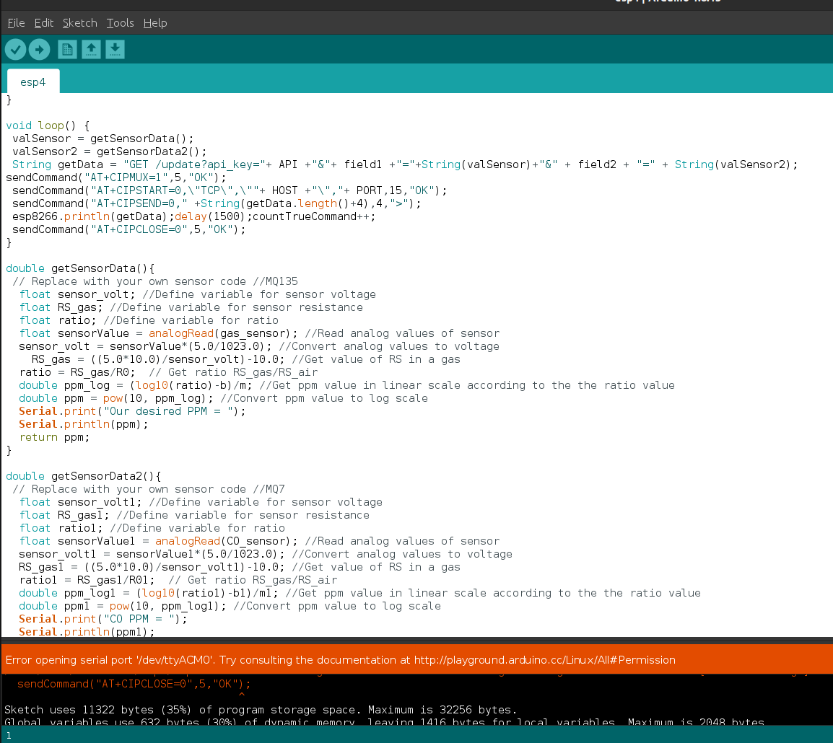
Fig 3 : Code on Arduino IDE

Slide 9
ThingSpeak Channel
ThingSpeak is an IoT analytics platform service that allows you to aggregate, visualize, and analyze live data streams in the cloud. You can send data to ThingSpeak from your devices, create instant visualization of live data, and send alerts.
For data aggregation I have made a thingspeak channel where i am collecting gas sensor and carbon monoxide sensor values.

Slide 10
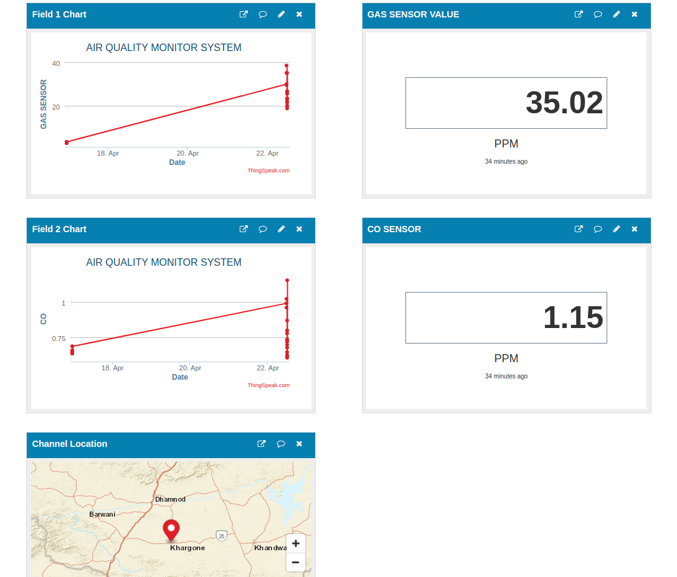
Fig 4 : ThingSpeak Channel Values

Slide 11
Android
I build the android app on Android Studio IDE using Java, XML. It basically shows the air quality in ppm. Based on air quality it shows status also whether air is good,moderate,unhealthy,very unhealthy and hazardous. You can also view current reading of gas sensor as well as Carbon Monoxide sensor as well as the previous trend graph of the data. I have also added text to speech feature in gas sensor pages. I have attached screenshots of all the screens.

Slide 12
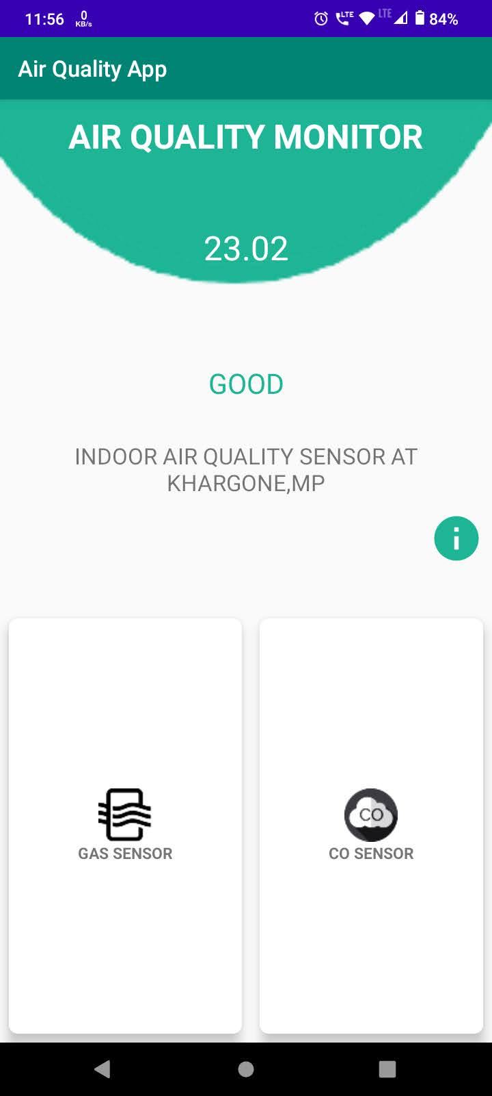
Fig 5 : Home Page

Slide 13
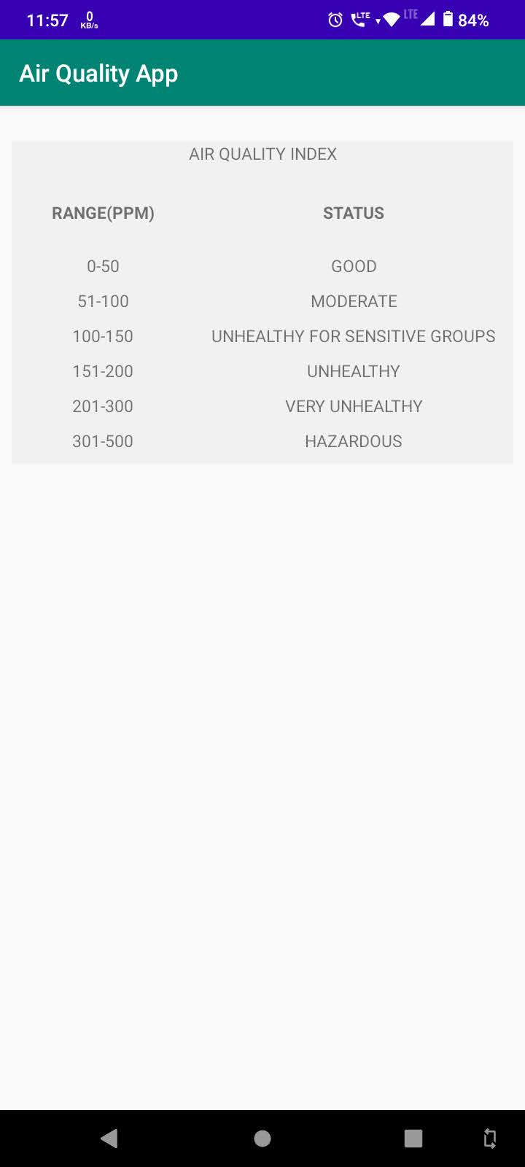
Fig 6: Info Page

Slide 14
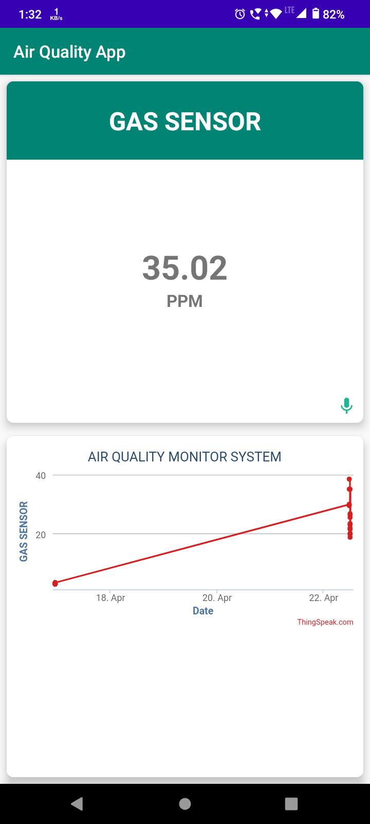
Fig 7 : Gas Sensor Page

Slide 15
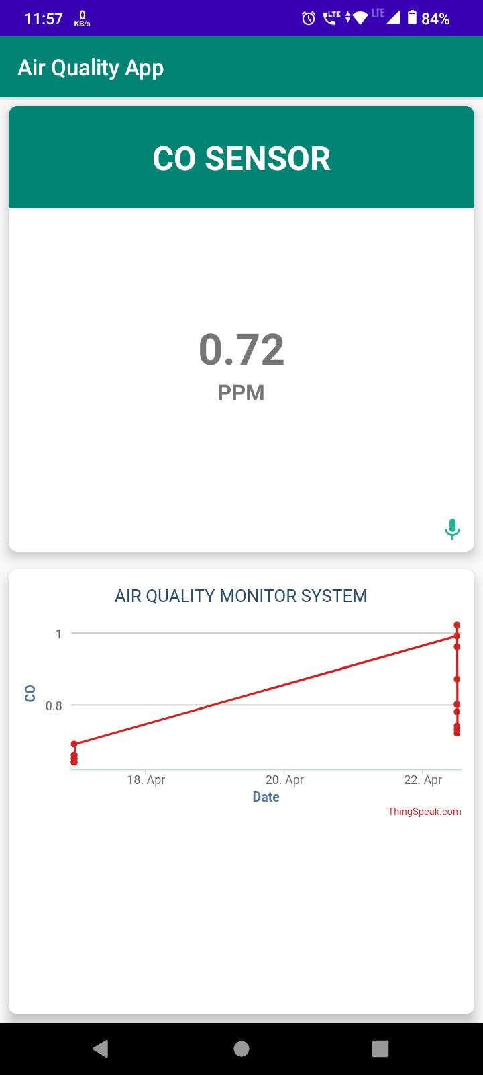
Fig 8 : Carbon Monoxide Sensor Page

Slide 16
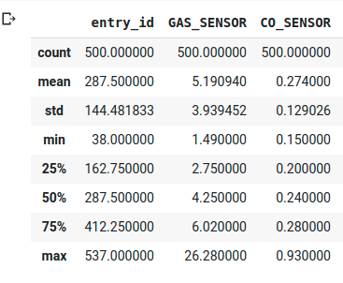
ANALYSIS FROM DATA

Slide 17
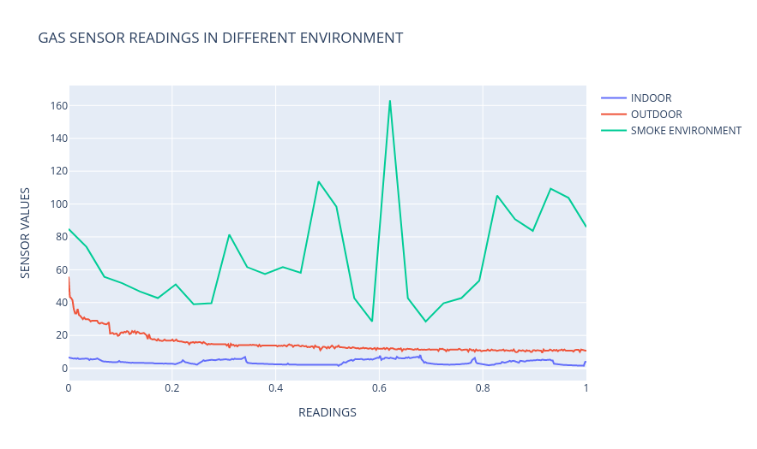
ANALYSIS FROM DATA
Fig 9 : GAS SENSOR DATA

Slide 18
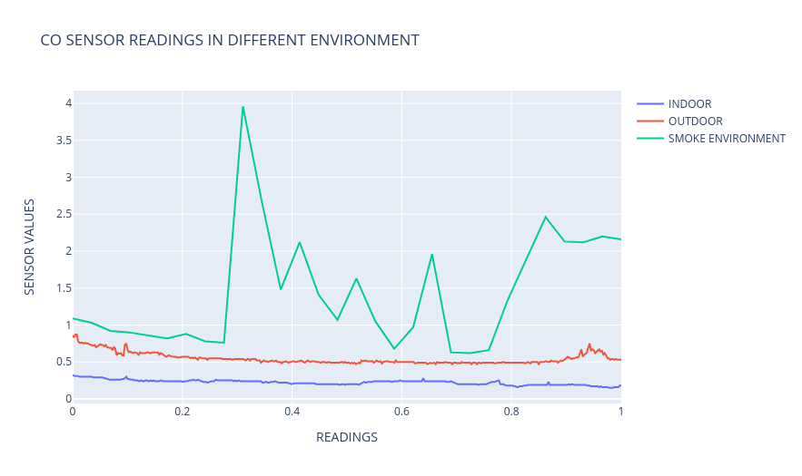
ANALYSIS FROM DATA
Fig 9 : CO SENSOR DATA

Slide 19
Results
Property | Base Paper | This Project
Sensors Cost | 48$ Alphasense brand sensors | 5$
Power Supply | 0.5 Watt for AQ device | 2.5 Watt for Arduino
Sensor Used | O3,NO2 | Gas Sensor, CO
Microcontroller | Raspberry pi | Arduino UNO
Cloud Service | Kairos DB, Graphana | ThingSpeak
Total Cost of Setup | 500$ | 50$
Android App | NO | YES

Slide 20
Market Analysis
Device Name | Price | Mobile App | URL
Kaiterra Laser Egg 2 Air Quality Monitor | 9,990 | No | tinyurl.com/34wdpsr6
Prana Air Quality Monitor | 6,490 | Yes | tinyurl.com/vtvptew7
Xuuxu Air Quality Monitor | 3599 | No | tinyurl.com/mae64426
SMILEDRIVE® Portable Air Quality Pollution Meter | 7299 | No | tinyurl.com/wsp5wsdm
AIRATOM Air Quality Monitor | 8,999 | No | tinyurl.com/kfz6nkvs

Slide 21
Market Analysis
Device Name | Price | Mobile App | URL
HealthInnovative G7015 | 5,149 | No | tinyurl.com/34wdpsr6
Crusaders AQI | 4999 | No | tinyurl.com/vtvptew7
IQAir Air Visual Air Quality Monitor | 25,300 | Yes | tinyurl.com/mae64426
Airveda Air Quality | 9,499 | Yes | tinyurl.com/wsp5wsdm
Airveda Air Quality With humidity | 19,008 | Yes | tinyurl.com/kfz6nkvs
Our Air Quality Monitoring System | 3000 | Yes

Slide 22
Conclusion
I have made an end to end air quality monitoring system. Now a days, there is a need of this kind of sensors because pollution is increasing day by day. Also the cost of the sensors should be reduced to as minimum as possible. Here the cost of overall system is very less as compared to any other air monitoring system in the market. And none of the commercial air quality monitoring devices gives you monitoring via an android app. I have tried to keep the hardware expenses at minimum but it can be further reduced by using cheaper hardware or different programmable boards. Now a days, There is age of smart systems and with the advancement of IOT we want everything at our fingertips so an Android App is ideal choice for monitoring purpose. Also I used thingspeak as data aggregation platform. This platform is easy to use, but it is little bit slow. Also i used the free version of thingspeak which has a daily limit of fixed messages.

Slide 23
Applications
Smart monitoring of house in case of gas leak which can cause fire.
Smart notifications for people who are sensitive of bad air quality can be notified.
Smoke detection from crop burning in nearby areas.
Connect with smart devices to close your windows automatically if smoke is coming from outside.
Air Quality monitoring at large scale in case of smart cities along with humidity and temperature.

Slide 24
Limitation And Future Work
Cost of hardware can be reduced further by using cheaper hardware or other NodeMCU based devices which can bring down cost further.
For Monitoring of multiple sensors situated at multiple locations the current thingspeak channel will not scale. A Database for handling data from all the different air quality sensor monitor units can be created.

Slide 25
References
Rashmi Ballamajalu, Srijith Nair, Shayal Chhabra, Sumit K. Monga, Anand SVR, Malati Hegde, Yogesh Simmhan, Anamika Sharma, Chandan M. Choudhary, Ronak Sutaria, Rajesh Zele, Sachchida N. Tripathi.(2018) Toward SATVAM: An IoT Network for Air Quality Monitoring. .CoRR, abs/1811.07847.,
Y. Simmhan (2019) SATVAM: Toward an IoT Cyber-Infrastructure for Low Cost Urban Air Quality Monitoring .doi: 10.1109/eScience.2019.00014
Kinnera, Bharath Kumar Sai Subbareddy, Somula & Luhach, Ashish (2019). Scalable Computing: Practice and Experience. IOT based Air Quality Monitoring System Using MQ135 and MQ7 with Machine Learning Analysis . 20. 599-606. 10.12694/scpe.v20i4.1561
Cho, R. (2018, June 26). What you should know about air quality alerts.Retrieved from https://phys.org/news/2018-06-air-quality.html

